Slide 1
Basic VHDL
RASSP Education & Facilitation
Module 10
Version 2.02
Copyright © 1995-1998 RASSP E&F
All rights reserved. This information is copyrighted by the RASSP E&F Program and may only be used for non-commercial educational purposes. Any other use of this information without the express written permission of the RASSP E&F Program is prohibited. All information contained herein may be duplicated for non-commercial educational use provided this copyright notice is included. No warranty of any kind is provided or implied, nor is any liability accepted regardless of use.
FEEDBACK:
The RASSP E&F Program welcomes and encourages any feedback that you may have including any changes that you may make to improve or update the material. You can contact us at feedback@rassp.scra.org or
http://rassp.scra.org/module-request/FEEDBACK/feedback-on-modules.html

Slide 2
Packages and Libraries
User defined constructs declared inside architectures and entities are not visible to other VHDL components
  Scope of subprograms, user defined data types, constants, and signals is limited to the VHDL components in which they are declared
Packages and libraries provide the ability to reuse constructs in multiple entities and architectures
  Items declared in packages can be used (i.e. included) in other VHDL components
Notes:
VHDL provides the package mechanism so that user-defined types, subprograms, constants, aliases, etc. can be defined once and reused in the description of multiple VHDL components.
VHDL libraries are collections of packages, entities, and architectures. The use of libraries allows the organization of the design task into any logical partition the user chooses (e.g. component libraries, package libraries to house reusable functions and type declarations).

Slide 3
Packages
Packages consist of two parts
  Package declaration -- contains declarations of objects defined in the package
  Package body -- contains necessary definitions for certain objects in package declaration
    e.g. subprogram descriptions
Examples of VHDL items included in packages :
  Basic declarations
    Types, subtypes
    Constants
    Subprograms
    Use clause
Signal declarations
Attribute declarations
Component declarations
Notes:
A package contains a collection of user-defined declarations and descriptions that a designer makes available to other VHDL entities. Items within a package are made available to other VHDL entities (including other packages) with a use clause. Some examples of possible package contents are shown above.
The next two slides will describe the two parts of a VHDL package, the package declaration and the package body.

Slide 4
Packages
Declaration
An example of a package declaration :
Note some items only require declaration while others need further detail provided in subsequent package body
  for type and subtype definitions, declaration is sufficient
  subprograms require declarations and descriptions
PACKAGE my_stuff IS
TYPE binary IS ( ON, OFF );
CONSTANT PI : REAL := 3.14;
CONSTANT My_ID : INTEGER;
PROCEDURE add_bits3(SIGNAL a, b, en : IN BIT;
SIGNAL temp_result, temp_carry : OUT BIT);
END my_stuff;
Notes:
This is an example of a package declaration. The package declaration lists the contents of the package. The declaration begins with the keyword PACKAGE and the name of the package followed by the keyword IS. VHDL declaration statements are then included, such as type declarations, constant declarations, and subprogram declarations. For many VHDL constructs, such as types, declarations are sufficient to fully define them. For a subprogram, however, the declaration only specifies the parameters required by the function or procedure; the operation of the subprogram appears later in the package body. The package declaration ends with END and the package name.

Slide 5
Packages
Package Body
The package body includes the necessary functional descriptions needed for objects declared in the package declaration
  e.g. subprogram descriptions, assignments to constants
PACKAGE BODY my_stuff IS
CONSTANT My_ID : INTEGER := 2;
PROCEDURE add_bits3(SIGNAL a, b, en : IN BIT;
SIGNAL temp_result, temp_carry : OUT BIT) IS
BEGIN -- this function can return a carry
temp_result <= (a XOR b) AND en;
temp_carry <= a AND b AND en;
END add_bits3;
END my_stuff;
Notes:
The package body contains the functional descriptions for the subprograms and other items declared in the corresponding package declaration.
Once a package is defined, its contents are made visible to VHDL entities and architectures via a USE clause which is analogous to the include statement of some other programming languages.

Slide 6
Packages
Use Clause
Packages must be made visible before their contents can be used
  The USE clause makes packages visible to entities, architectures, and other packages
-- use only the binary and add_bits3 declarations
USE my_stuff.binary, my_stuff.add_bits3;
... ENTITY declaration...
... ARCHITECTURE declaration ...
-- use all of the declarations in package my_stuff
USE my_stuff.ALL;
... ENTITY declaration...
... ARCHITECTURE declaration ...
Notes:
Packages are made visible to a VHDL description through the use of the USE clause. This statement comes at the beginning of the entity or architecture file and makes the contents of a package available within that file.
The USE clause can select all or part of a particular package. In the first example above, only the binary data type and add_bits3 procedure are made visible. In the second example, the full contents of the package are made visible by use of the keyword ALL in the use clause.

Slide 7
Libraries
Analogous to directories of files
  VHDL libraries contain analyzed (i.e. compiled) VHDL entities, architectures, and packages
Facilitate administration of configuration and revision control
  E.g. libraries of previous designs
Libraries accessed via an assigned logical name
  Current design unit is compiled into the Work library
  Both Work and STD libraries are always available
  Many other libraries usually supplied by VHDL simulator vendor
    E.g. proprietary libraries and IEEE standard libraries
Notes:
Increasingly complex VLSI technology requires configuration and revision control management. Additionally, efficient design calls for reuse of components when applicable and revision of library components when necessary.
VHDL uses a library system to maintain designs for modification and shared use. VHDL refers to a library by an assigned logical name; the host operating system must translate this logical name into a real directory name and locate it. The current design unit is compiled into the Work library by default; Work is implicitly available to the user with no need to declare it. Similarly, the predefined library STD does not need to be declared before its packages can be accessed via use clauses. The STD library contains the VHDL predefined language environment, including the package STANDARD which contains a set of basic data types and functions and the package TEXTIO which contains some text handling procedures.

Slide 8
IEEE Library
IndustryStandard
Custom and Third part libraries- risk of incompatibilities
  For instance, packages originated inSynopsys (std_logic_signed and std_logic_unsigned)
Main packages
  std_logic_1164
  std_logic_textio
  std_logic_arith
  numeric_bit
  numeric_std
Notes:
From http://www.bitweenie.com/listings/vhdl-type-conversion/
By Shannon Hilbert
Any given VHDL FPGA design may have multiple VHDL types being used. The most common VHDL types used in synthesizable VHDL code are std_logic, std_logic_vector, signed, unsigned, and integer. Because VHDL is a strongly-typed language, most often differing types cannot be used in the same expression. In cases where you can directly combine two types into one expression, you are really leaving it up to the compiler or synthesis tool to determine how the expression should behave, which is a dangerous thing to do.

Slide 9
Std_Logic Type
From Std_logic_1164 package
Std_Logic Type is an enumerated type with following values (alternative to BIT type):
    'U', -- Uninitialized
    'X', -- Forcing Unknown
    '0', -- Forcing 0
    '1', -- Forcing 1
    'Z', -- High Impedance
    'W', -- Weak Unknown
    'L', -- Weak 0
    'H', -- Weak 1
    ‘-' -- Don't care

Slide 10
Std_Logic Type
Std_Logic_Vector
  Array of Standard_logic
All important Logic Operations are defined
No arithmetic Oparations are defined
  Std_logic_arith must be used for that
  Std_logic_vector can be used for both signed and unsigned data under std_logic_arith operations
  Confusing to use both signed and unsigned data in a same code

Slide 11
Signed and Unsiged Types
From Numeric_Std package
Signed and Unsigned types are vectors extended form std_logic_vector
Example of 4 bit signed and unsigned
  unsigned ‘1010’ means decimal 10
  signed ‘1010’ means decimal -6
It is a de facto standard (only numeric package accepted by all comercial tools)
Notes:
From http://www.bitweenie.com/listings/vhdl-type-conversion/
By Shannon Hilbert
Using the Correct VHDL Type
Although it’s possible to perform many math functions using the std_logic_vector type, doing that is unnecessarily difficult in digital signal processing (DSP) designs. Use the signed and unsigned types to keep track of your precision and sign type. After all, why use VHDL if you’re not going to harness the power of the strong typing?
Don’t leave it up to the compiler or synthesis tool to figure out what operation you want to perform or what an expression result should be!

Slide 12
Signed and Unsiged Types
All important Logic (bitwise) and Arithmetc Operations are defined
Through numeric_std package, signed and unsigned types bridge integer and std_logic_vector
Conversion function (to and from integer)
Typecasting (from and to std_lçogic_vector)

Slide 13
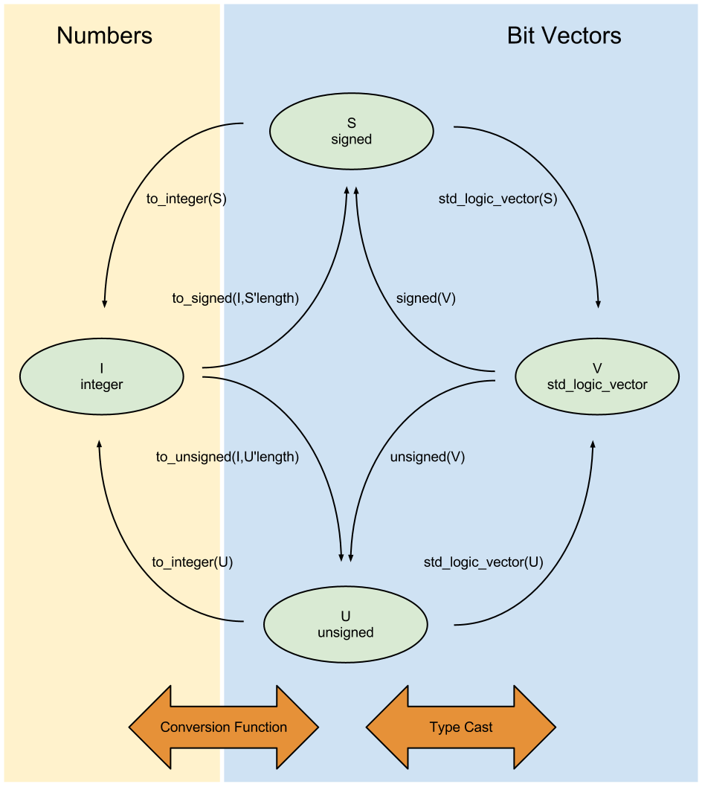
Conversion function / Typecasting
From :
http://www.bitweenie.
com/wp-
content/uploads/2013
/02/vhdl-type-
conversions.png
Notes:
From http://www.bitweenie.com/listings/vhdl-type-conversion/
By Shannon Hilbert
Type casting is used to move between the std_logic_vector type and the signed and unsigned types.
1 --signal definitions
2 signal slv : std_logic_vector(7 downto 0);
3 signal s : signed(7 downto 0);
4 signal us : unsigned(7 downto 0);
5
6 --FROM std_logic_vector TO signed/unsigned
7 sgn <= signed(slv);
8 usgn <= unsigned(slv);
9
10 -- FROM signed/unsigned TO std_logic_vector
11 svl <= std_logic_vector(sgn);
12 svl <= std_logic_vector(usgn);
Functions are used to move between signed and unsigned types and the integer type.
--signal definitions
2 signal i : integer;
3 signal sgn : signed(7 downto 0);
4 signal usgn : unsigned(7 downto 0);
5
6 --FROM integer TO signed/unsigned
7 sgn <= to_signed(i,8);
8 usgn <= to_unsigned(i,8);
9
10 -- FROM signed/unsigned TO integer
11 i <= to_integer(sgn);
12 i <= to_integer(usgn);
An easy way to remember when to use function or type cast is to remember that both the std_logic_vector and signed/unsigned types both are defined with a specific bit width, while integers do not define a bit width.
A type cast between std_logic_vector and signed/unsigned can be used as long as the origin and destination signals have the same bit width. Integers do not have a set bit width, which is why the conversion function from integer to signed/unsigned includes a specification of the intended bit width.
As a side note on integers:
Notice that there is no direct conversion path between the std_logic_vector type and the integer type. Integer types do not have a set width, unlike signed, unsigned, and std_logic_vector types. To convert between integer and std_logic_vector types, you must first convert to signed or unsigned.
If you do not restrict the range when defining an integer, the compiler will assume a 32-bit width. Depending on your synthesis tool and its settings, the default bit width of 32 may or may not be optimized out to the appropriate bit width.

Slide 14
Conversion function / Typecasting
Example of Conversion Function
constant vec : std_logic_vector(15 downto 0);
signal count : std_logic_vector(3 downto 0);
signal element : std_logic;
...
element <= vec(to_integer(unsigned(count),4));
Notes:
Some common examples of situations needing to use type casting or conversion are in mathematical expressions. Another very common use is when you want to use a counter value as in index into an array.
A common use is converting a std_logic_vector or unsigned type to an integer so that it can be used as an array index. Arrays can only be indexed with integers.

Slide 15
Conversion function / Typecasting
Example of Typecasting
signal sum_u : unsigned(11 downto 0);
signal sum_s : signed(11 downto 0);
constant a : unsigned(3 downto 0) := X"A";
sum_u <= counter_fr + (X"00" & a);
sum_s <= signed(counter_fr) + signed(X"00" & a);
Notes:
Take a look at what happens when we subtract two unsigned numbers.
Depending on whether the result is defined as signed or unsigned, the results are drastically different. When counter_fr holds the value 1000 (binary), sum_u=18 and sum_s=2. That’s because the binary value 1000 is 8 unsigned and -8 two’s complement signed.

Slide 16
Attributes
Attributes provide information about certain items in VHDL
  E.g. types, subtypes, procedures, functions, signals, variables, constants, entities, architectures, configurations, packages, components
General form of attribute use :
VHDL has several predefined, e.g :
  X'EVENT -- TRUE when there is an event on signal X
  X'LAST_VALUE -- returns the previous value of signal X
  Y'HIGH -- returns the highest value in the range of Y
  X'STABLE(t) -- TRUE when no event has occurred on signal X in the past ‘t’ time
name'attribute_identifier -- read as “tick”
Notes:
Attributes may be used to communicate information about many different items in VHDL. Similarly, attributes can return various types of information. For example, an attribute can be used to determine the depth of an array, its range, its leftmost index, etc. Additionally, the user may define new attributes to cover specific situations. This capability allows user-defined constructs and data types to use attributes. An example of the use of attributes is in assigning information to a VHDL construct, such as board location, revision number, etc.
A few examples of predefined VHDL attributes are shown above. Note that, by convention, the apostrophe marking the use of an attribute is pronounced tick (e.g. 'EVENT is pronounced "tick EVENT").

